Slide 1

Original author: Yehuda Katz
https://github.com/emberjs/ember.js/
http://emberjs.com/
Current version v2.7.0
Notes:
Self-introduction and quick introduction about Ember.js (history, author, version …. )
1 min

Slide 2
Agenda
Ember.js Core Concepts
Organizing Ember application
Practical concerns (TBU) / Lessons learned (TBU)
Notes:
Briefing agenda, quick walkthrough
Core concepts: how an Ember application works (basic structure), what tools provided out of the box
Organize Ember app: standard MVC structure, Ember POD structure, Unified structure (just theory for the moment) and demo a real-world application structure
Concerns: server-side rendering with FastBoot, build tool (ember-cli)
1 min

Slide 3
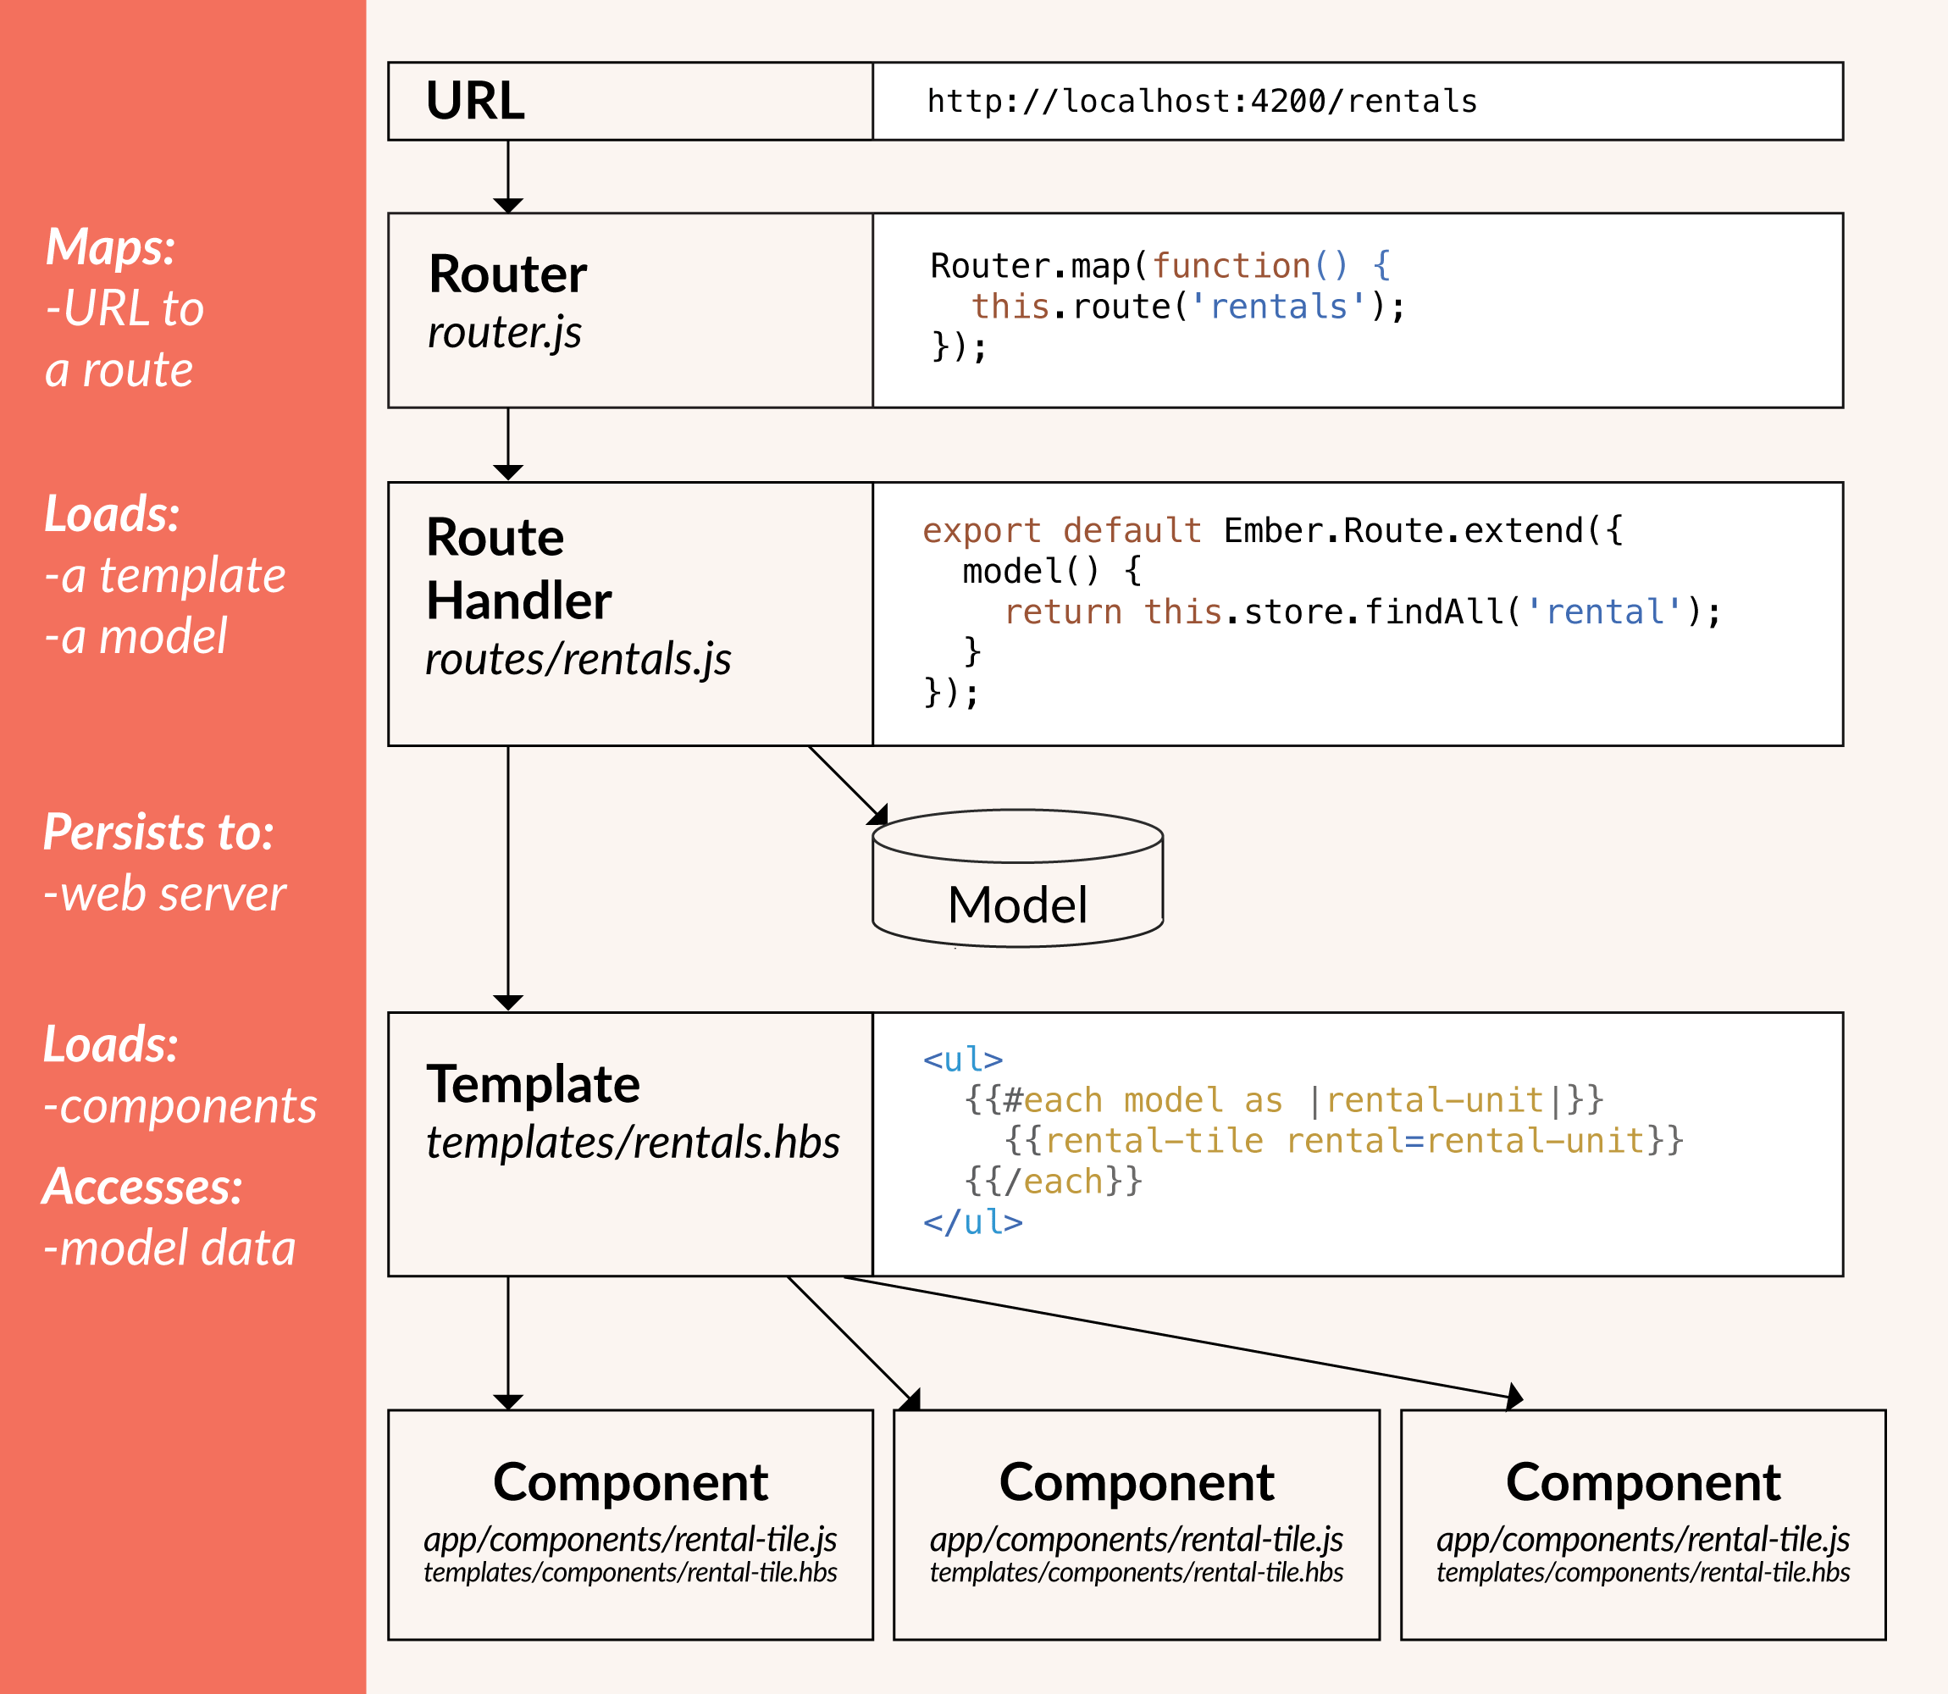
Core concepts - Overview
Notes:
Brief introduction to some of Ember core concepts and overview of all
Routing (define route and route handler)
HTML template with Handlebars
Model
2 mins

Slide 4
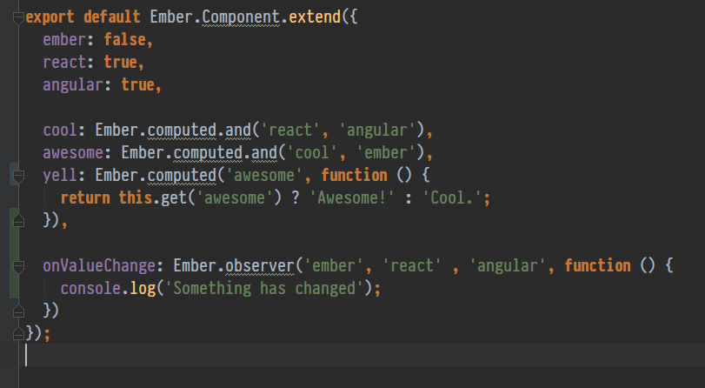
Core concepts
Objects in Ember
Computed Properties
Observers
Bindings
Notes:
Should not be confused with Model.
Models are objects that represent the underlying data. (And it uses Ember object not plain JavaScript object)
5 mins – including demo

Slide 5
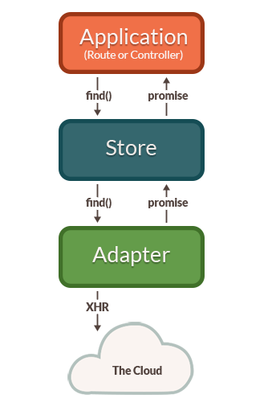
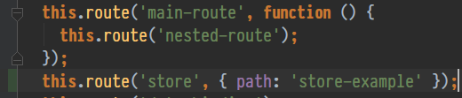
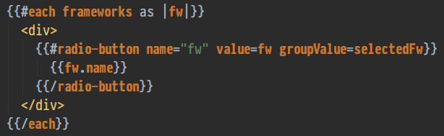
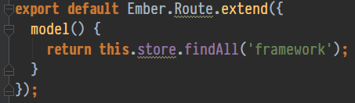
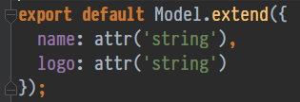

Core concepts
Routes
Templates
Components
Model
Store
Notes:
This is main part. Everything is provided out of the box, we don’t have to config anything else.
5-7 mins – including demo

Slide 6
Organizing your application
Standard MVC structure:
app/routes/main-route.js
app/routes/main-route/nested-route.js
app/templates/main-route.hbs
PODS structure:
app/pods/main-route/route.js
app/pods/main-route/template.hbs
app/pods/main-route/nested-route/route.js
app/pods/main-route/nested-route/template.hbs
app/pods/other-route/route.js
app/pods/other-route/template.hbs
Notes:
Group by type,
Group by feature, others can be centralized, such as: services, adapters, models (define in one place and use for all other components, route).

Slide 7
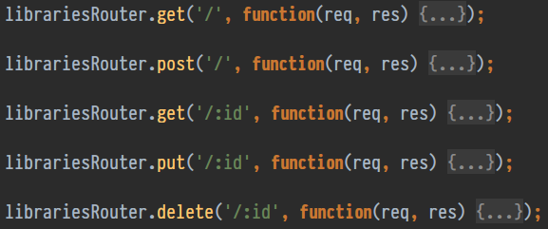
Practical concerns / Lessons learned
Standard REST API querying
Development
Server-side rendering
Notes:
1 - End up writing ajax middleware if the API does not follow REST or JSONAPI standard, in some cases we have to manage data on our own =>
can’t leverage the store which is one of the best features of Ember.
2 – Fast and easy development environment with ember-cli, just one command line and you have a fully functional mockup API, generated route/component
3 – Now possible with FastBoot
Some other concerns:
Using ES6/7 with Ember ( `this` context)
Rendering performance (Glimmer)
Tightly coupling with jQuery

Slide 8
Thanks for listening!
Notes:
Takeaway values:
Basic concepts
Some factors that will help to determine to use in your project or not

